Slide 1
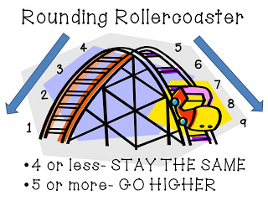
Unit 1 Numbers and Operations in Base 10
I can use place value to round
numbers to the nearest 10
and 100.
I can fluently add and subtract within
1000 using
Place Value
Properties of Operations
Understanding the relationship between addition and subtraction
I can draw scaled picture and bar graphs to represent several categories of data.
Solve one and two step problems
How many more
How many less
I can generate data using rulers with measurements of halves and fourths
I can create a Line Plots using whole numbers, halfs, and fourths

